Slide 1
ECE191: Group D Audio, Visual, and Touch Communication
Mentor: Truong Nguyen, Siarhei Vishniakou
Linh Dinh, Francis Tsui, Joseph Lee

Slide 2
Agenda
Background
Project Overview
Statement of Work
Gantt Chart
Next Week’s Goals

Slide 3
Background
“Sensing Fusion” – creating device that assimilates another sense into currently available devices on the market
Specifically: Touch
Design pressure sensor and array of actuators
Collect data from pressure sensor
Send data to produce pressure output on array of actuators
Application interface to make applicable

Slide 4
Project Overview
Design a mobile app (iOS or Android)
Receive data from Arduino over Bluetooth
Process data (at least 1 of the following):
Display a 3D surface plot of the data (drafting software)
Use data to drive a game
Drive an array of actuators (?)

Slide 5
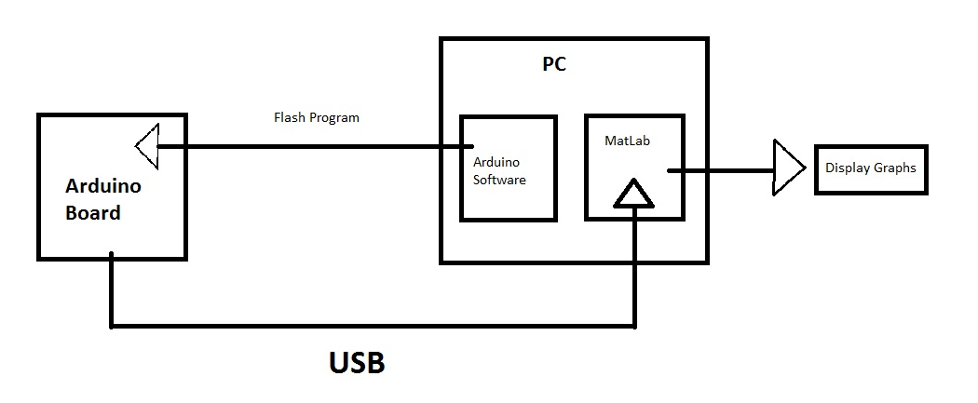
Statement of Work
Stage 1
Step 1: Flash program onto Arduino, emulating data of pressure sensor
Step 2: Receive data from Arduino in MATLAB via USB
Step 3: Do image processing on data

Slide 6
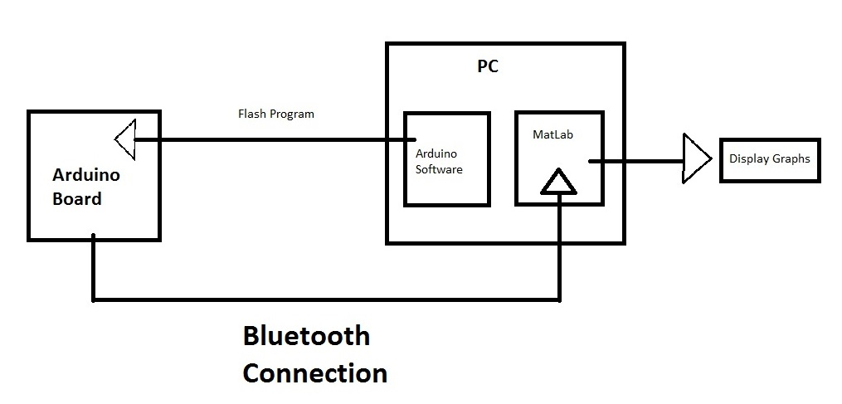
Statement of Work
Stage 2
Replace USB connection from stage 1 with Bluetooth connection
Notes:
Replacing Bluetooth connection into the system instead!

Slide 7
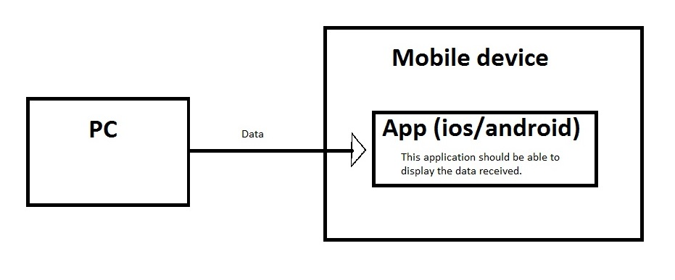
Statement of Work
Stage 3
App development to process data from sensor on mobile device
Device may include iOS, Android, Windows environment
Notes:
We want to make 2D or 3D graph on the phone to demonstrate abilities

Slide 8
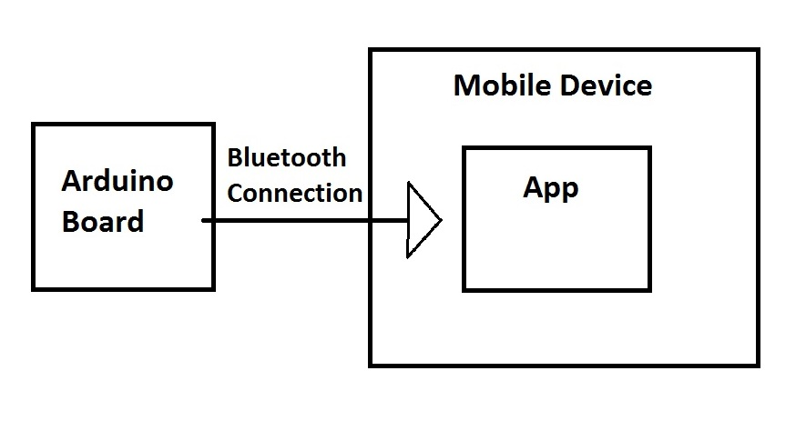
Statement of Work
Stage 4
Step 1: Receive data from Arduino via Bluetooth connection
Step 2: display data on application built from stage 3
Step 3: debug and finalize
Notes:
Configure the Bluetooth connection into the mobile app

Slide 9
Gantt Chart

Slide 10
Next Week’s Goals
Flash data from PC to Arduino
Flash code on Arduino that generates 8x8 random array
Research wired data transfer between Arduino and MATLAB

